Slide 1


Conception of a MAR application
to evaluate the river flooding impact in Coimbra Mehdi Lamrabet
Master in Informatic Engineering
Erasmus+ MSc internship Academic year 2023-2024
June 14th 2024

Slide 2
Conception of a MAR application
to evaluate the river flooding impact in Coimbra student: Mehdi Lamrabet supervisors: Jorge Almeida and Mateus Mendes Erasmus+ MSc Internship 2023-2024

Slide 3
Structure
Conception of a MAR application
to evaluate the river flooding impact in Coimbra
Mehdi Lamrabet
Introduction
Problem, challenges and goal
Methodology
Workflow, material, algorithms, evaluation of the model
Results
Correlations, models, mobile application
Discussion
Mondego river, hardware limitations
Main contributions
Conclusion
Improvements
Front page of future article

Slide 4
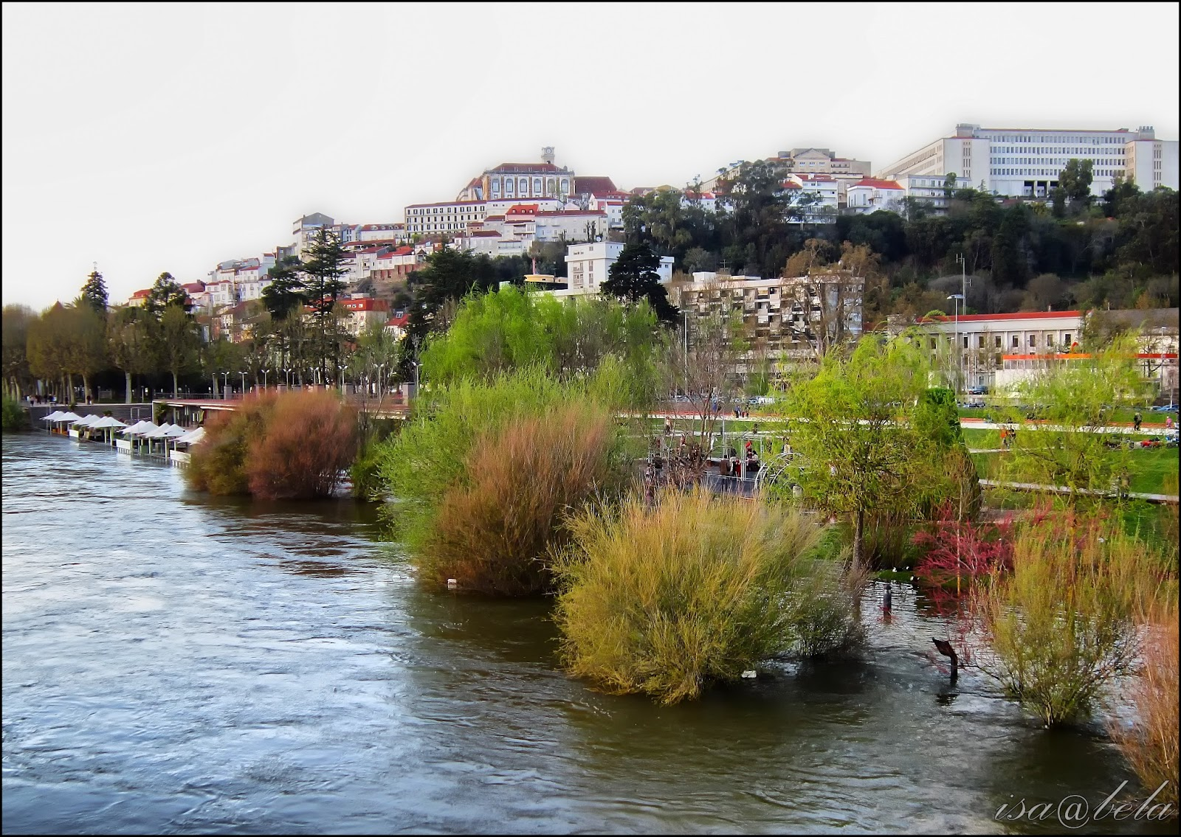
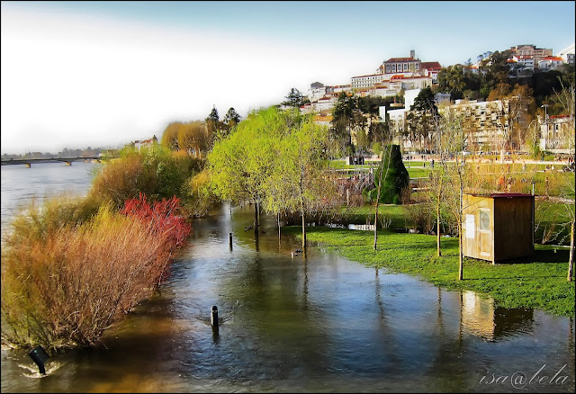
1 Problem
Conception of a MAR application
to evaluate the river flooding impact in Coimbra
Mehdi Lamrabet
Coimbra has been flooded several times
Economics and environmental impacts
Need to visualize complex data into a low price setup
https://umpigodeluz.blogspot.com/2013/04/cheias-e-o-rio-mondego-parque-mondego.html

Slide 5
2 Challenges
Conception of a MAR application
to evaluate the river flooding impact in Coimbra
Mehdi Lamrabet
Time limitations : 1 semester
Lack of data
Hardware : mobile device
Using and mastering several software applications

Slide 6
3 Goal
Conception of a MAR application
to evaluate the river flooding impact in Coimbra
Mehdi Lamrabet
Finding a prediction model based on regression analysis
Create a MAR application to display and change the water plane
Displaying information of impacted buildings
Development of a mobile application to close the gap between the user and real world problems

Slide 7
4 Methodology
Conception of a MAR application
to evaluate the river flooding impact in Coimbra
Mehdi Lamrabet

Slide 8

Materials & Software
Conception of a MAR application
to evaluate the river flooding impact in Coimbra
Mehdi Lamrabet
Samsung Galaxy A12
Image target
Unity 3D with Vuforia package
Blender with BLosm plugin
Google Earth (reference)
https://www.samsung.com/pt/smartphones/galaxy-a/galaxy-a12-nacho-black-32gb-sm-a127fzkueub/

Slide 9
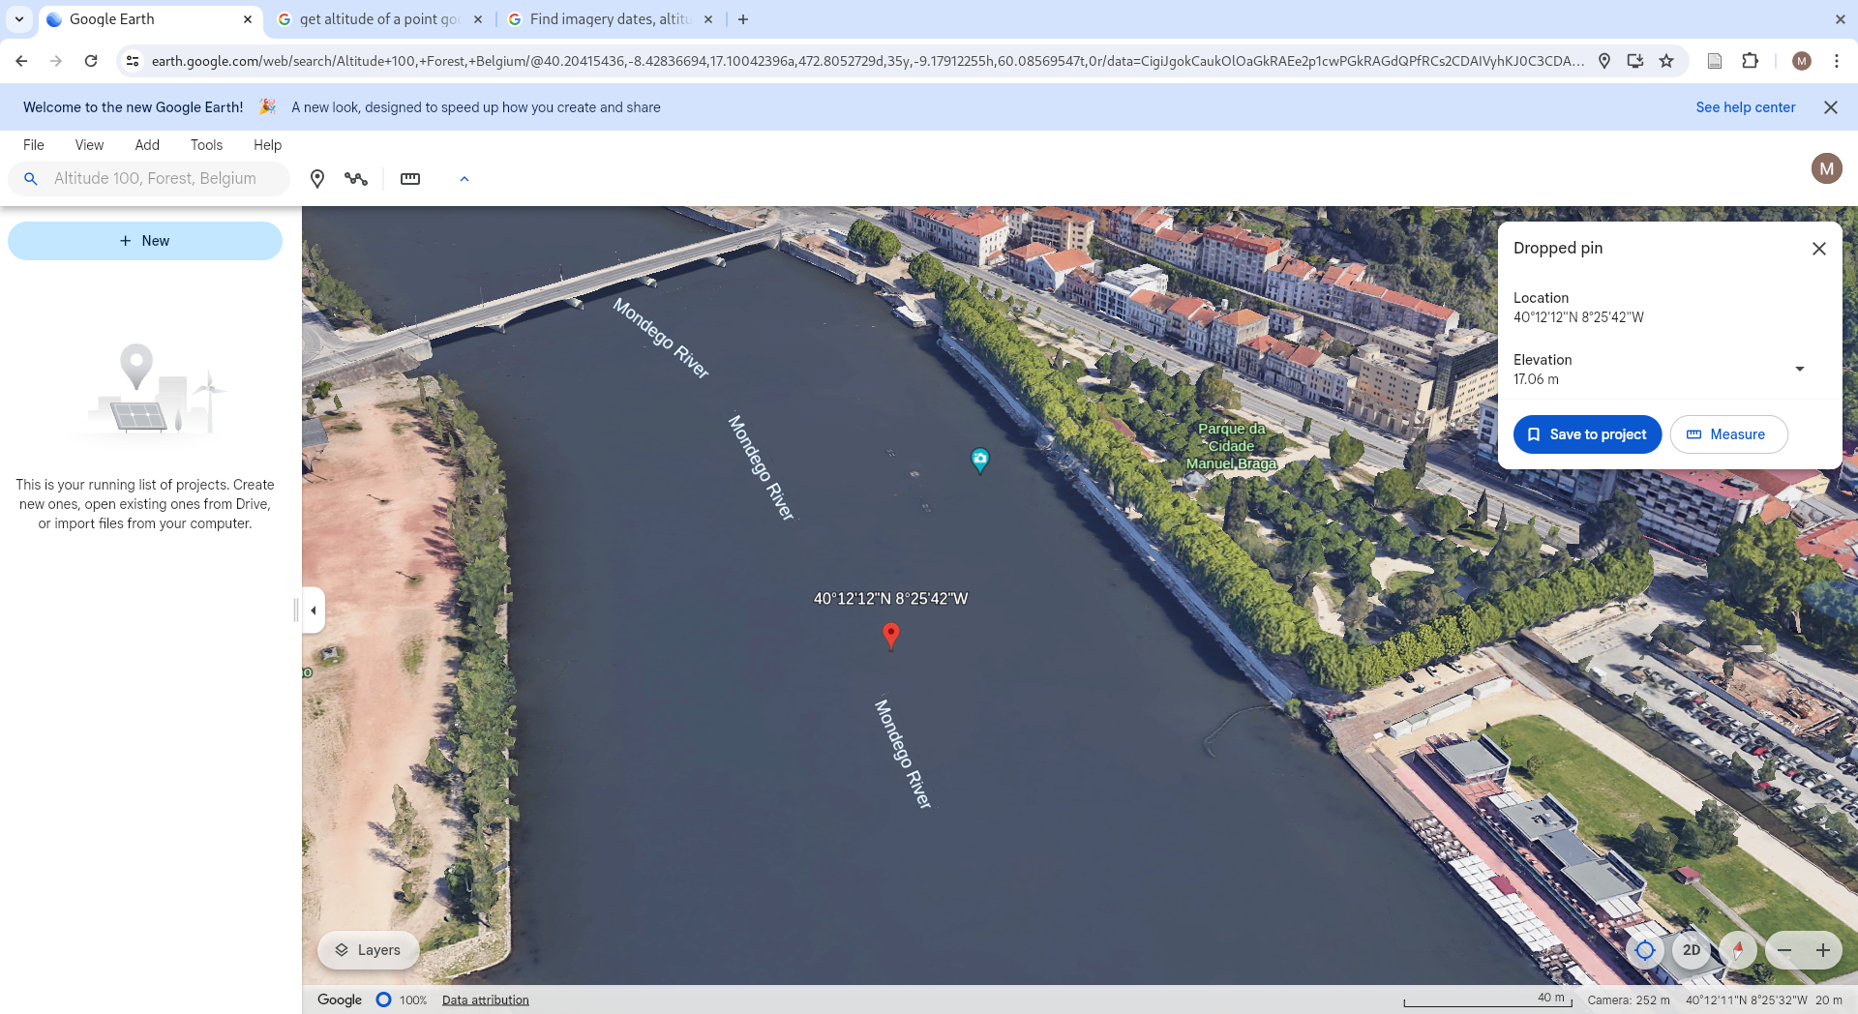
Reference from Google Earth
Conception of a MAR application
to evaluate the river flooding impact in Coimbra
Mehdi Lamrabet

Slide 10
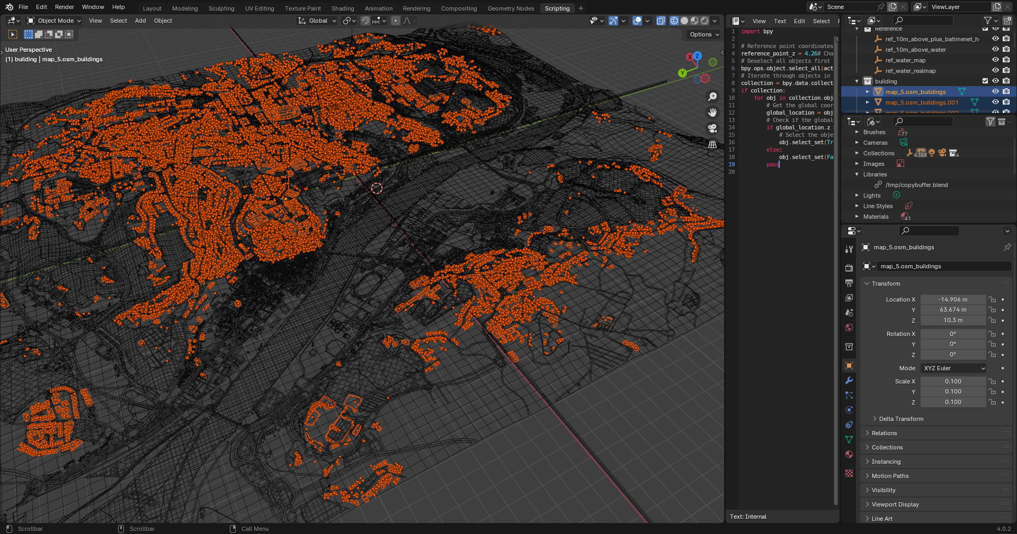
Blender with BLosm
Conception of a MAR application
to evaluate the river flooding impact in Coimbra
Mehdi Lamrabet

Slide 11
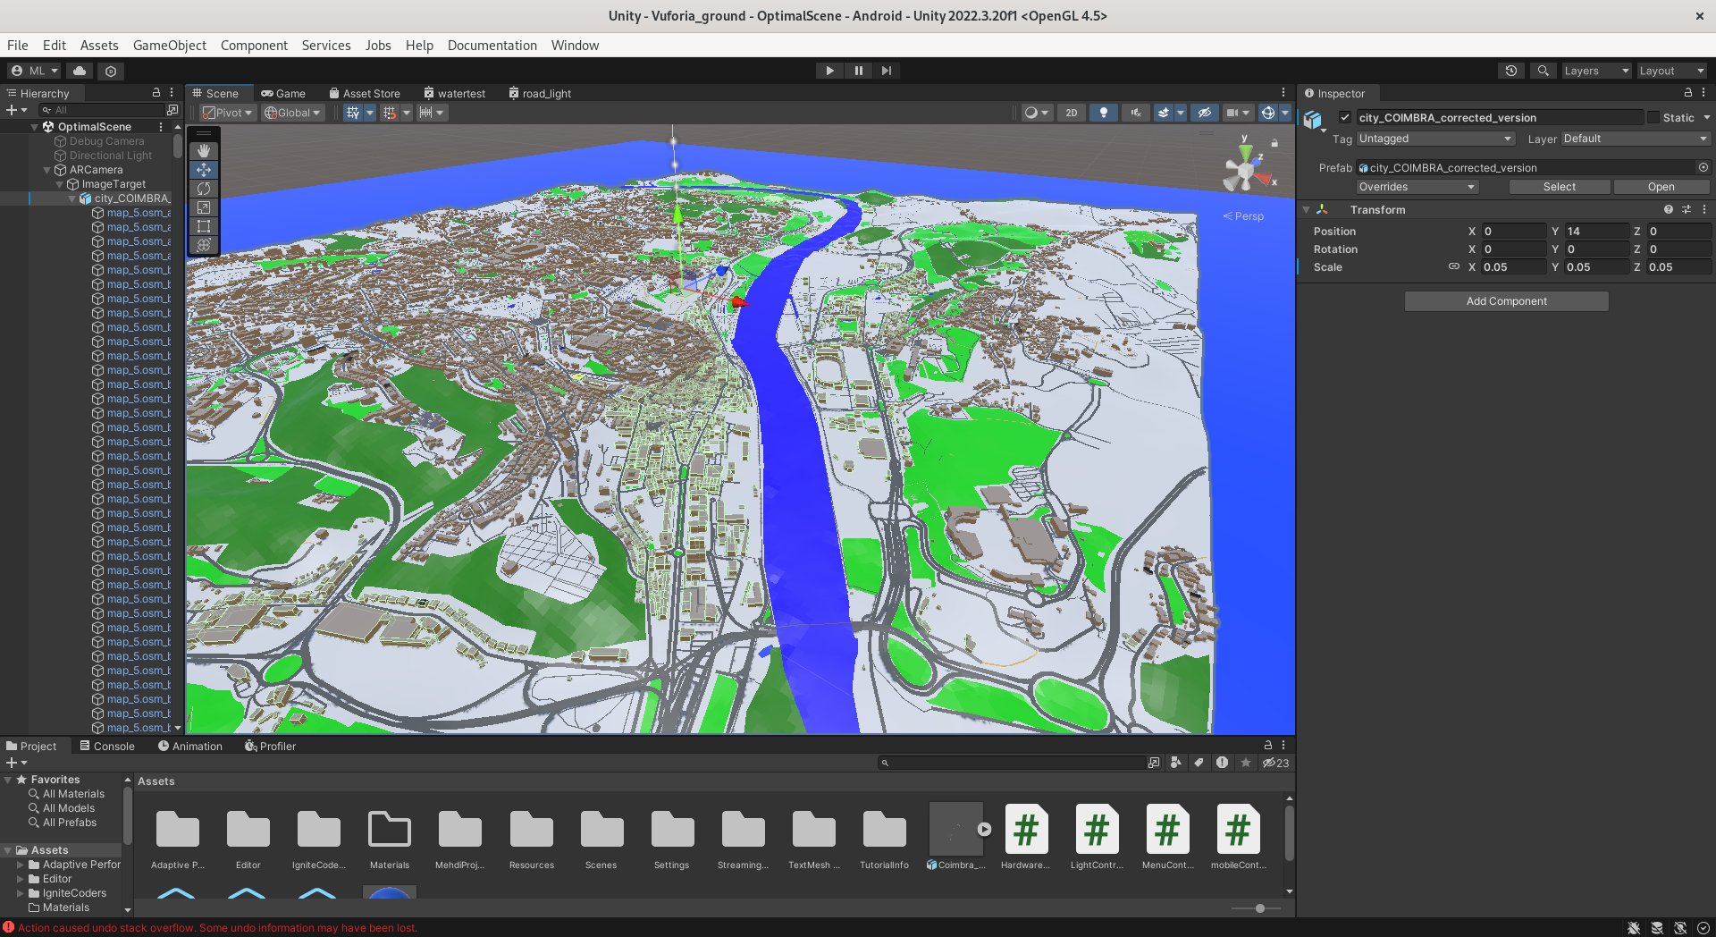
Unity 3D with Vuforia package
Conception of a MAR application
to evaluate the river flooding impact in Coimbra
Mehdi Lamrabet

Slide 12
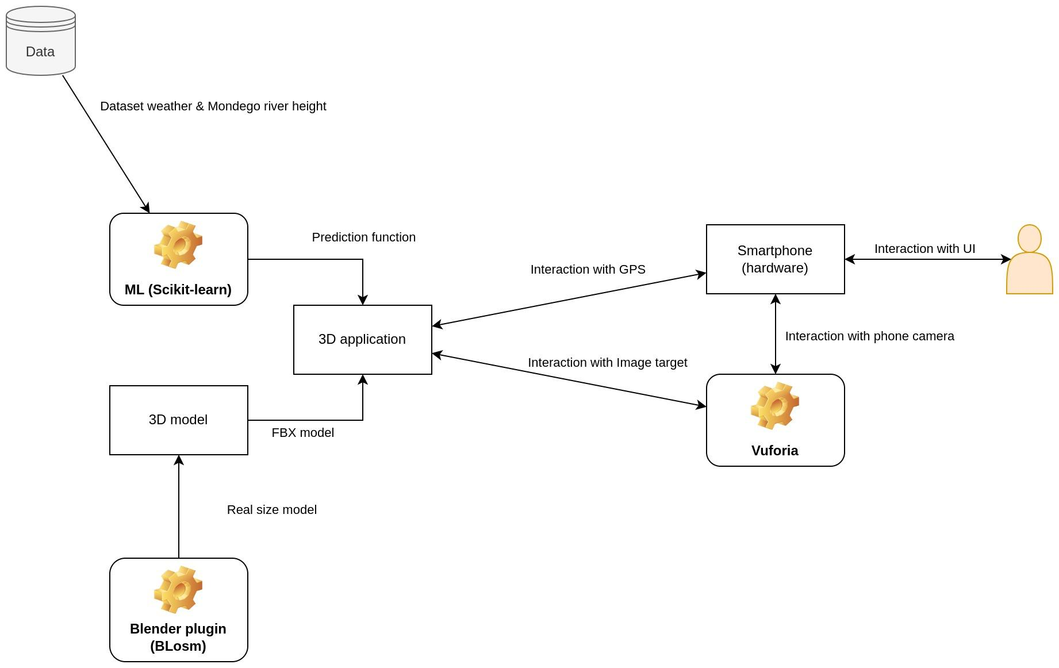
Workflow
Conception of a MAR application
to evaluate the river flooding impact in Coimbra
Mehdi Lamrabet

Slide 13
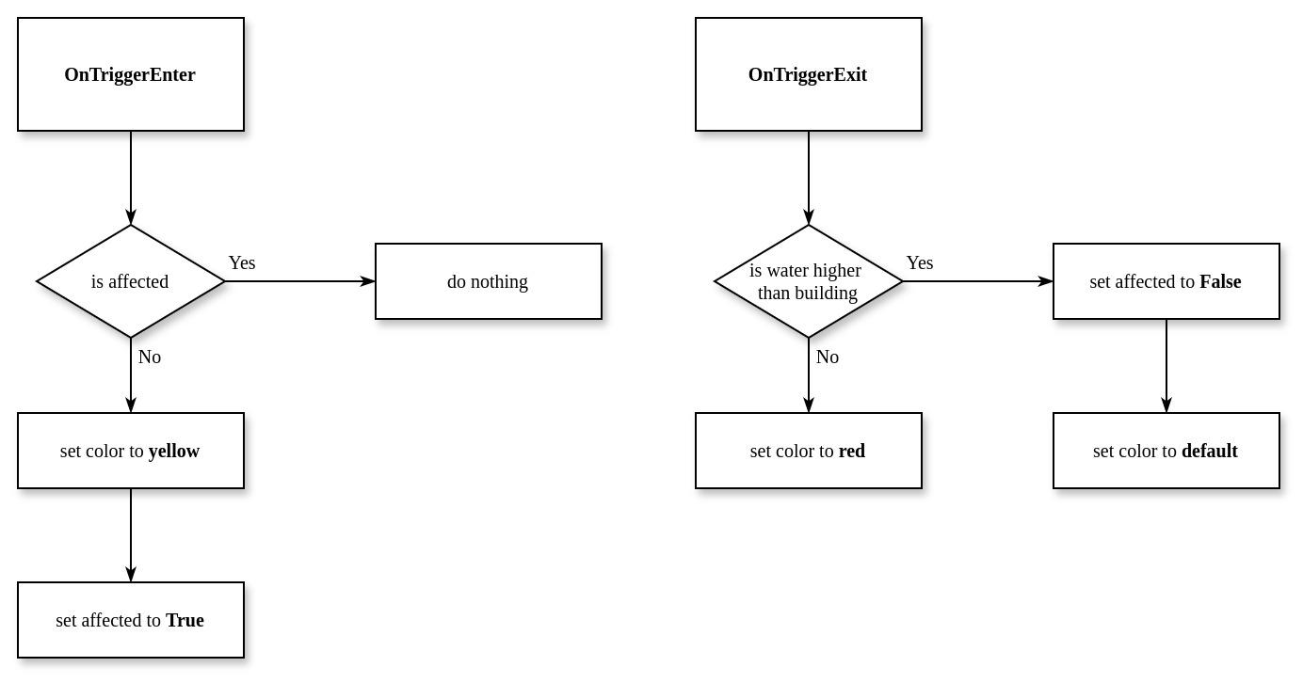
Algorithm for detection of affected buildings
Conception of a MAR application
to evaluate the river flooding impact in Coimbra
Mehdi Lamrabet

Slide 14
Analysis and ML model
Conception of a MAR application
to evaluate the river flooding impact in Coimbra
Mehdi Lamrabet
Choice of dataset & acquisition
Historical weather data for Coimbra (2000-2024)
River water height (CLMS portfolio)
Use of correlation heat map
Finding highest correlation to obtain a model
Evaluation of a prediction model
Using Scikit-learn libraries
Evaluate the prediction model and obtain results
Using this model in the final project to manipulate the water plane

Slide 15
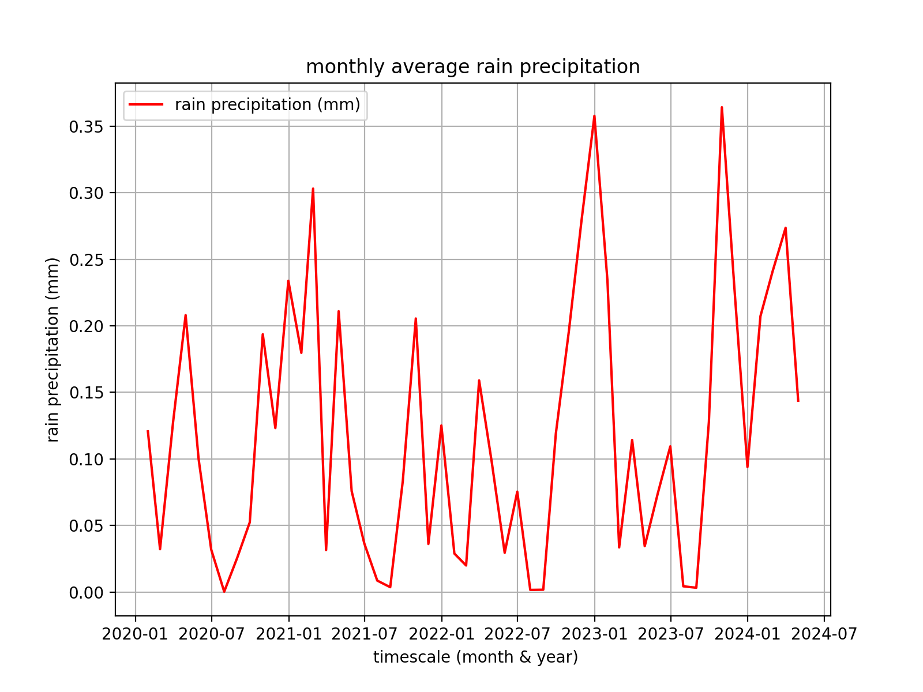
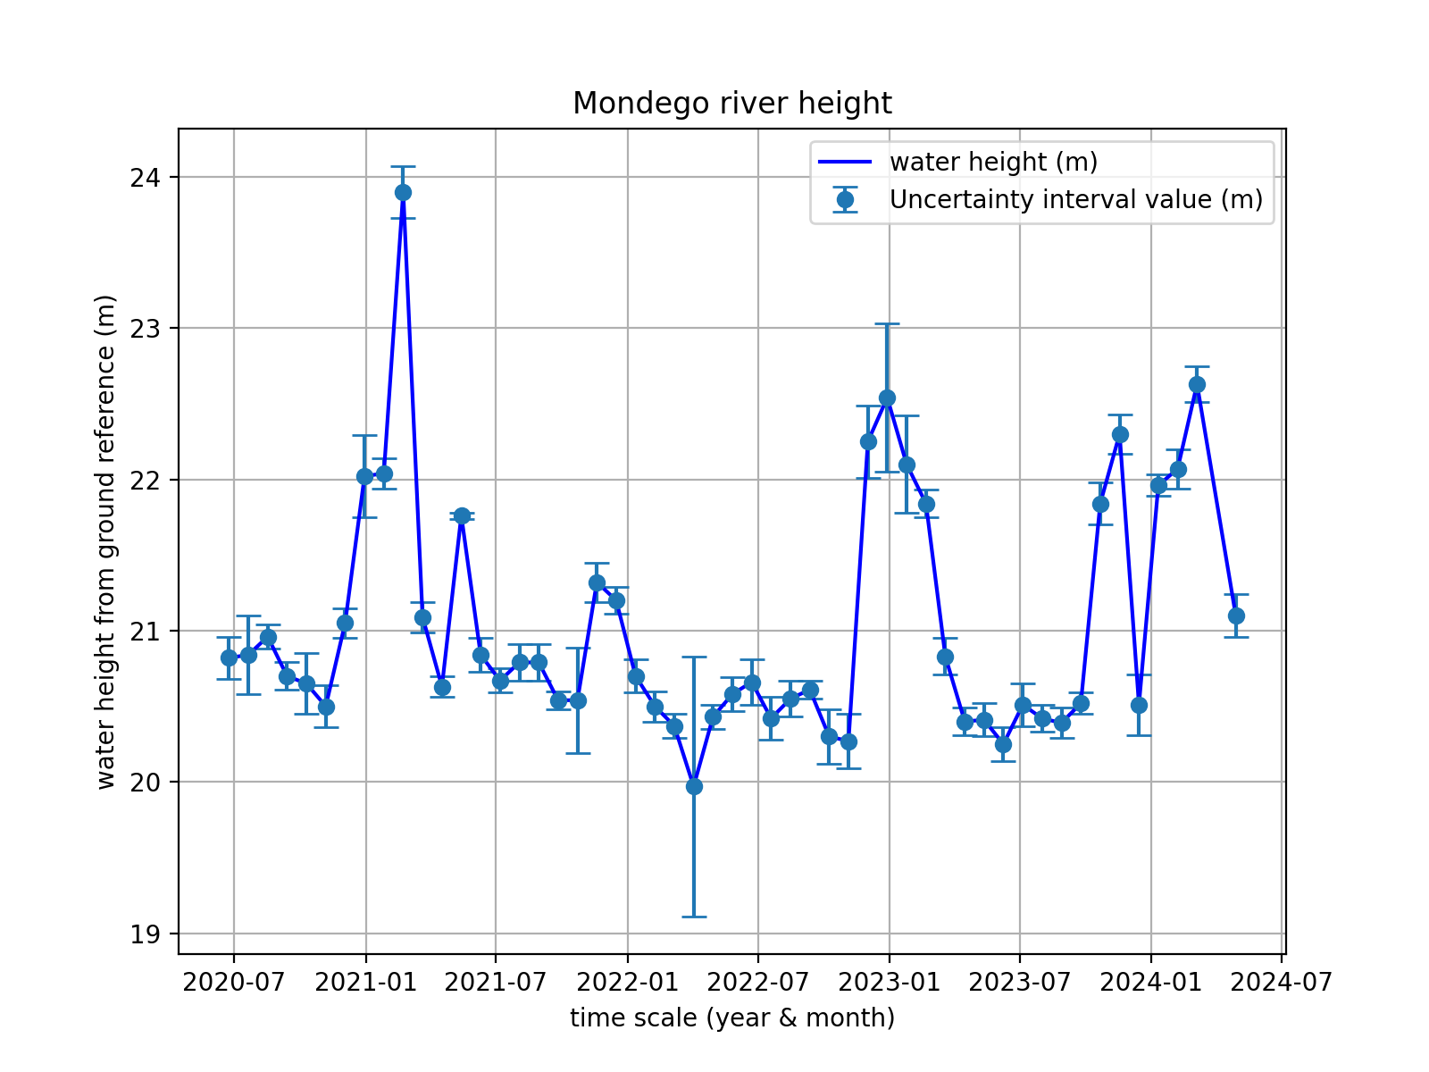
Analysis of data
Conception of a MAR application
to evaluate the river flooding impact in Coimbra
Mehdi Lamrabet
River water height data is monthly and precipitation is hourly
Average precipitation to obtain monthly value

Slide 16
Evaluation of the prediction model
Conception of a MAR application
to evaluate the river flooding impact in Coimbra
Mehdi Lamrabet
30% of data for testing and 70% for training
LinearRegression Scikit-learn module
Coefficient obtain is used in Unity 3D

Slide 17
5 Results
Conception of a MAR application
to evaluate the river flooding impact in Coimbra
Mehdi Lamrabet

Slide 18
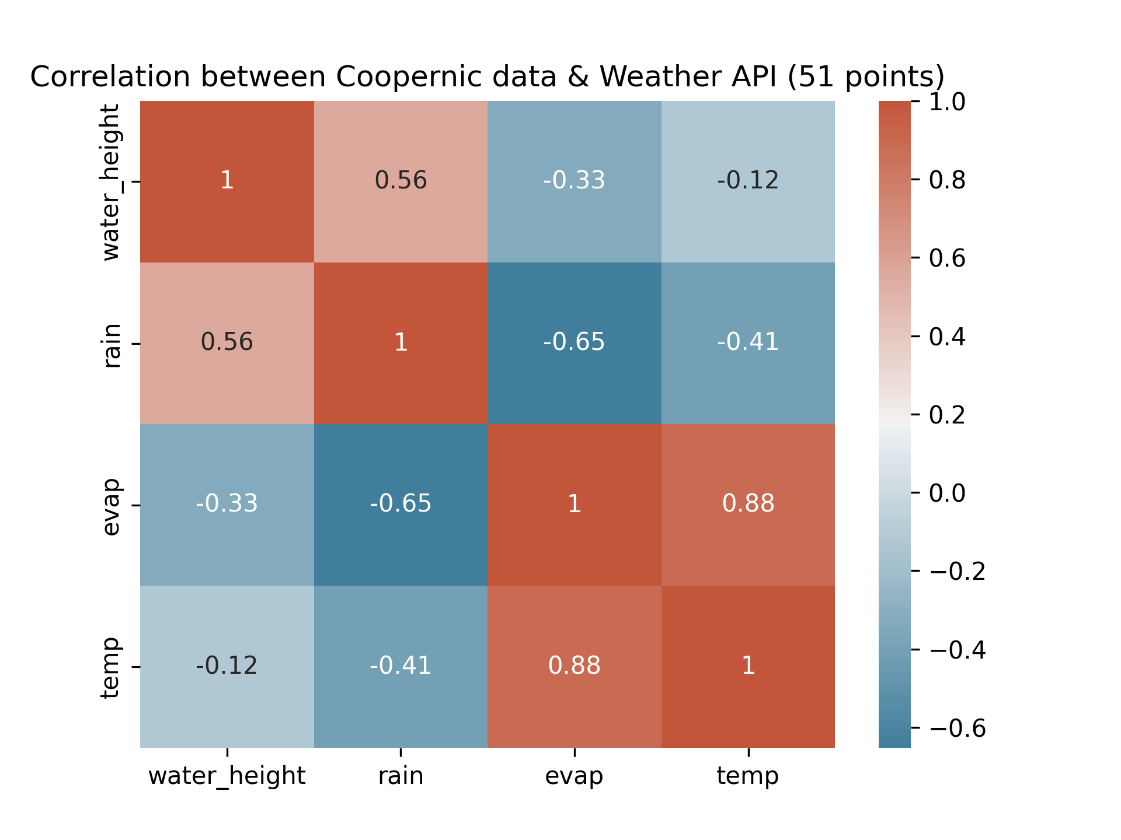
Correlation between variables
Conception of a MAR application
to evaluate the river flooding impact in Coimbra
Mehdi Lamrabet
Heatmap ease the understanding
Rain has the highest correlation with water height, at 0.56

Slide 19
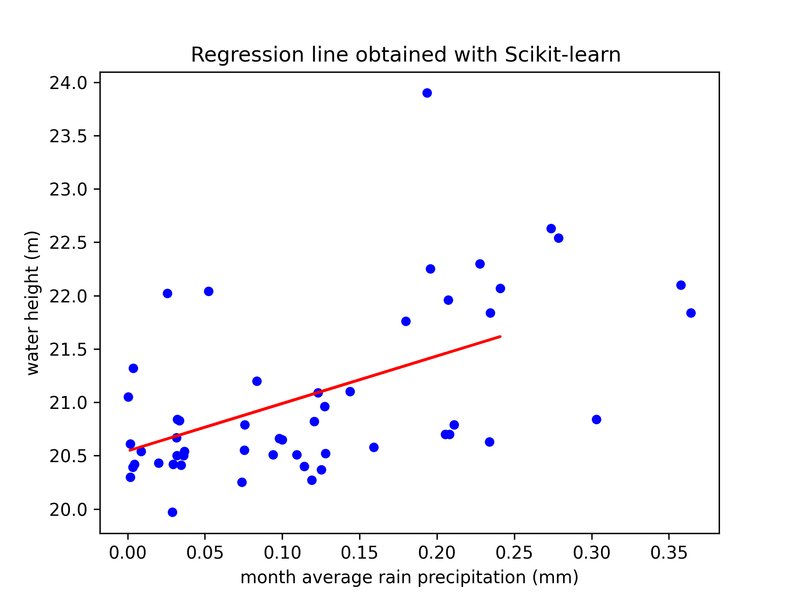
Predicted model - regression line
Conception of a MAR application
to evaluate the river flooding impact in Coimbra
Mehdi Lamrabet
Correlation existing between precipitation and water height
Existing trend

Slide 20
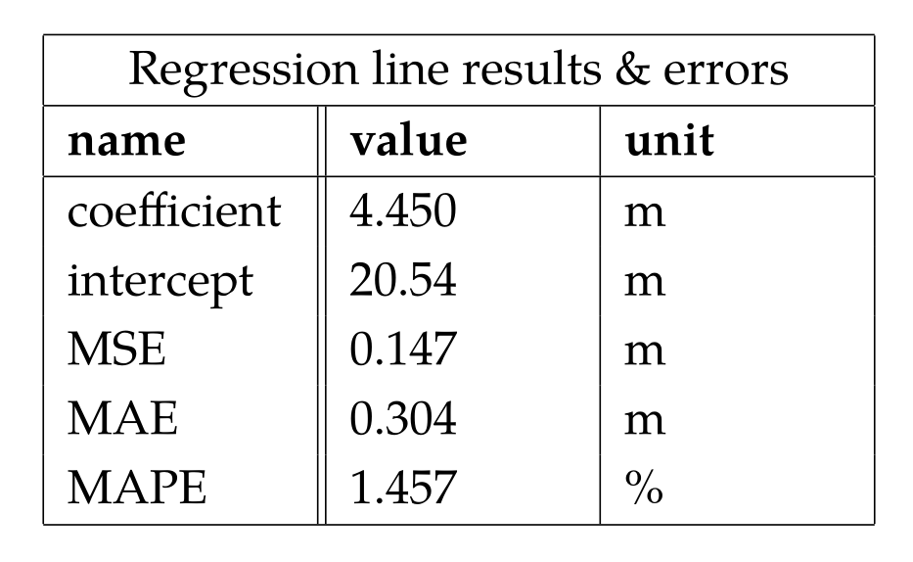
Predicted model - coefficient & errors
Conception of a MAR application
to evaluate the river flooding impact in Coimbra
Mehdi Lamrabet
Mean absolute percentage error is at 1,457%
Intercept is corresponding to the average height from the location of measures
For each month average rain mm value, an increase of 4,45 meter of water height

Slide 21
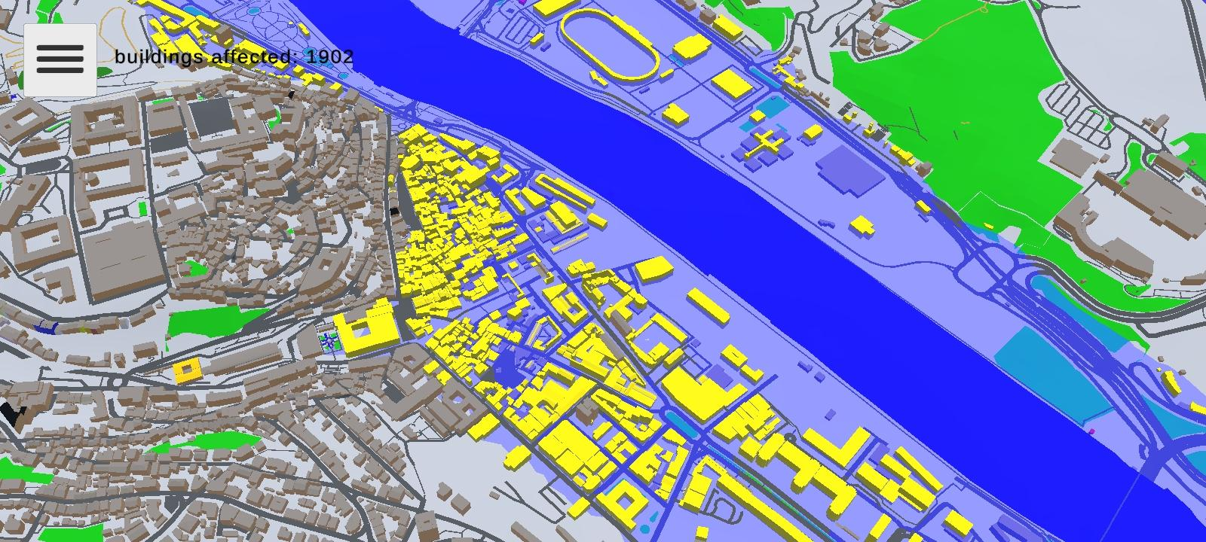
Impacted buildings
Conception of a MAR application
to evaluate the river flooding impact in Coimbra
Mehdi Lamrabet

Slide 22
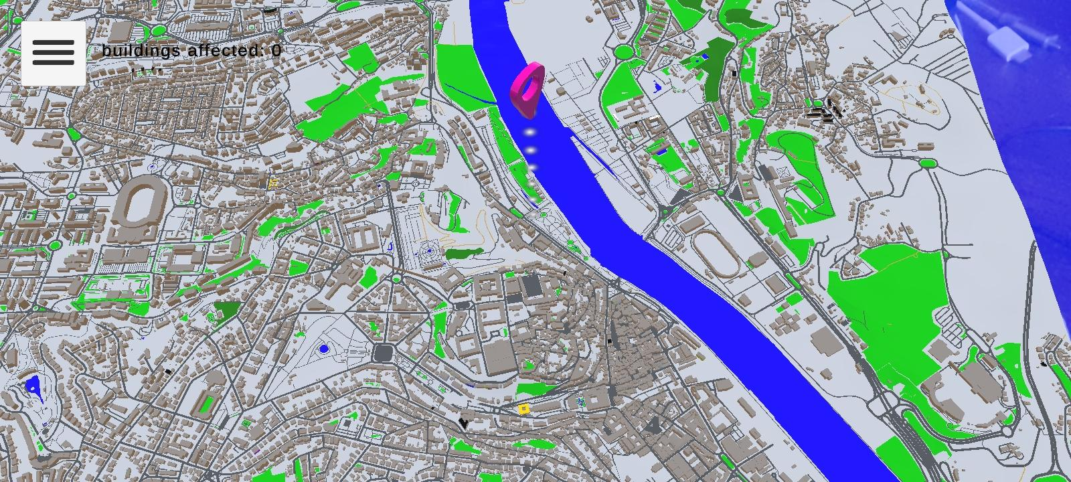
GPS mapping
Conception of a MAR application
to evaluate the river flooding impact in Coimbra
Mehdi Lamrabet

Slide 23
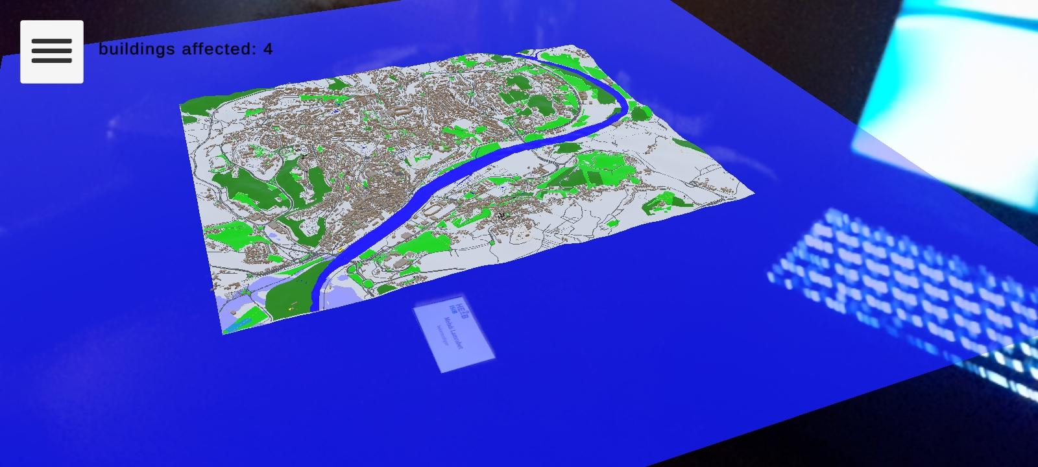
Image target tracking
Conception of a MAR application
to evaluate the river flooding impact in Coimbra
Mehdi Lamrabet

Slide 24
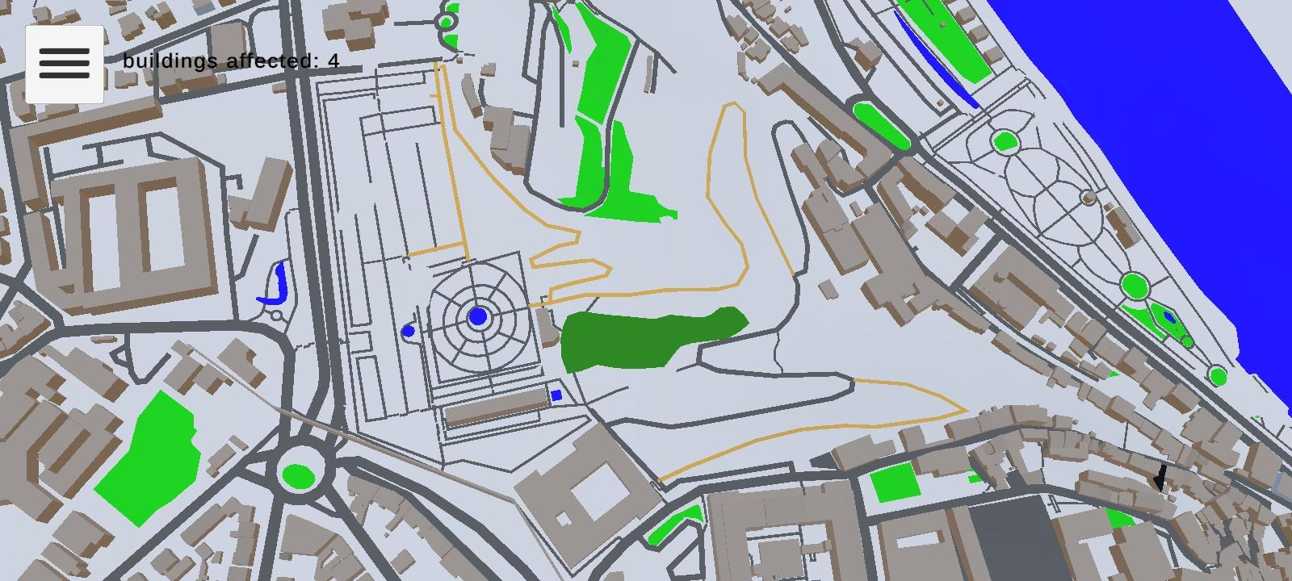
User interface - main
Conception of a MAR application
to evaluate the river flooding impact in Coimbra
Mehdi Lamrabet

Slide 25
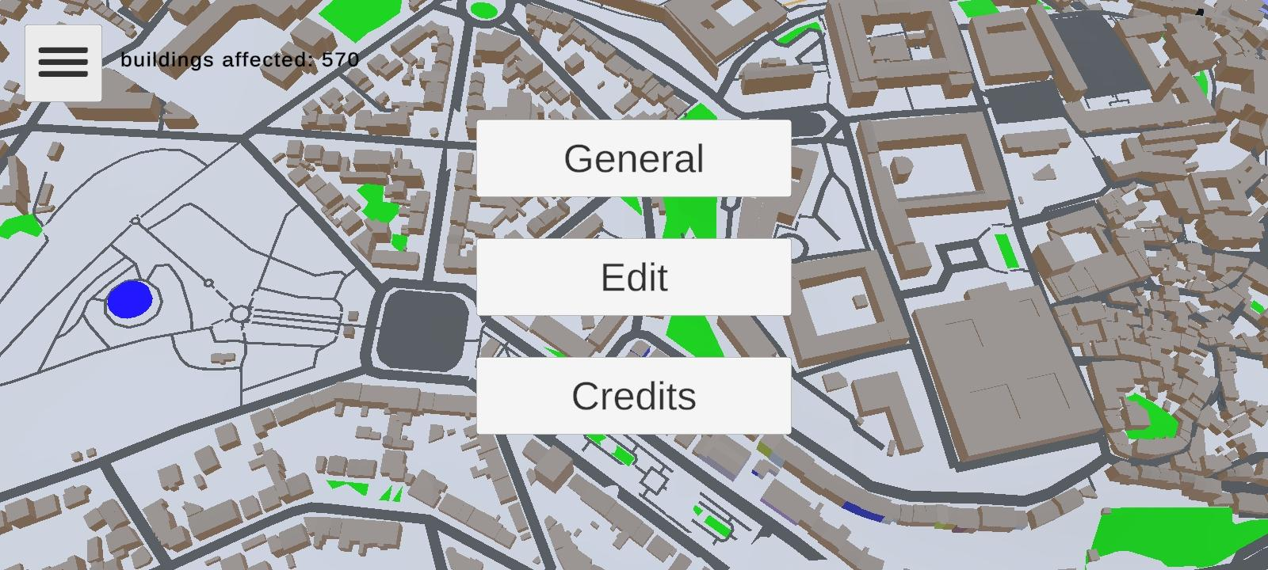
User interface - UI menu
Conception of a MAR application
to evaluate the river flooding impact in Coimbra
Mehdi Lamrabet

Slide 26
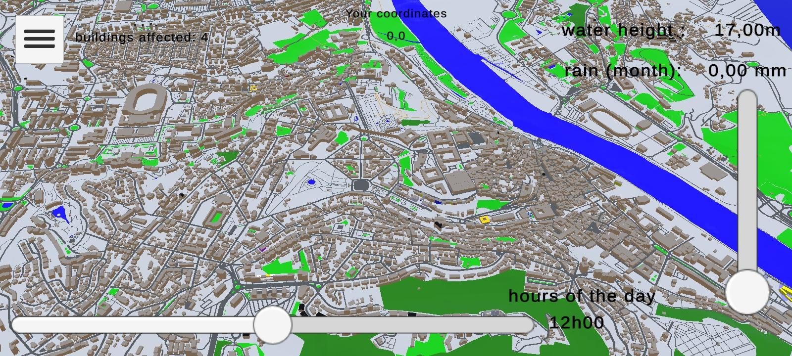
User interface - UI edit
Conception of a MAR application
to evaluate the river flooding impact in Coimbra
Mehdi Lamrabet

Slide 27
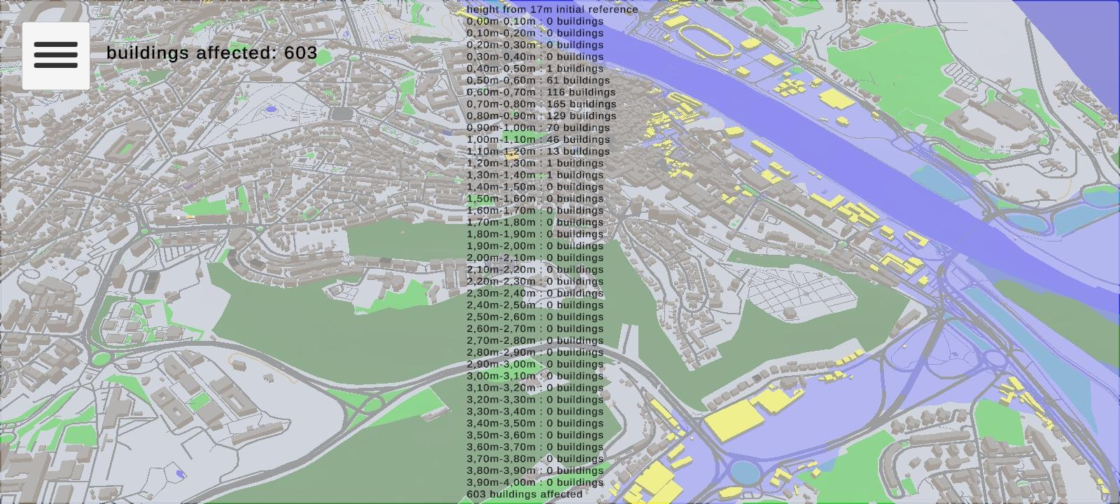
User interface - UI general
Conception of a MAR application
to evaluate the river flooding impact in Coimbra
Mehdi Lamrabet

Slide 28
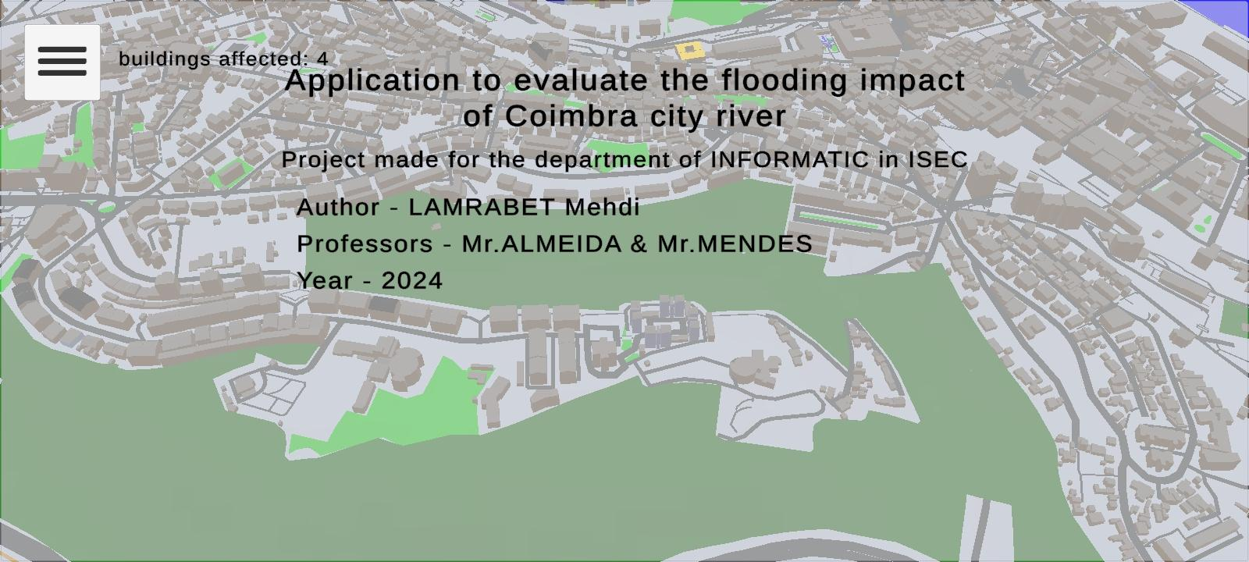
User interface - UI credits
Conception of a MAR application
to evaluate the river flooding impact in Coimbra
Mehdi Lamrabet

Slide 29
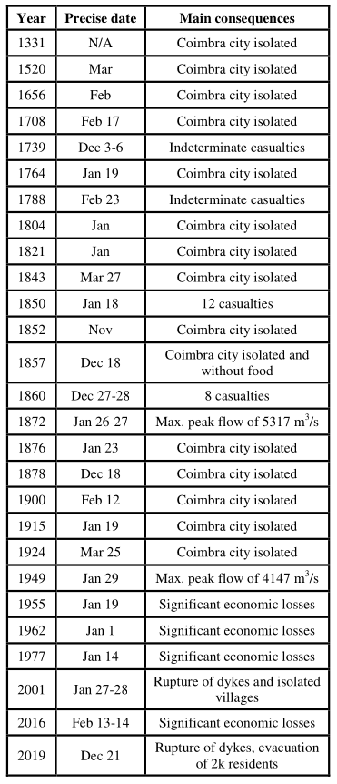
6 Discussion
Conception of a MAR application
to evaluate the river flooding impact in Coimbra
Mehdi Lamrabet
Riverfront populated by business and public infrastructures.
Lack of data
Hardware limitations for AR
Santos P.P et al., “Physical and human factors of the mondego river flood impacts in Coimbra”

Slide 30
7 Main contributions
Conception of a MAR application
to evaluate the river flooding impact in Coimbra
Mehdi Lamrabet
Optimisation of 3D models through extraction and simplifications
Regression line to predict Mondego river water height
Color-coded indicators to simplify representation of affected buildings
Integration of AR and ML into a MAR
Use of low price entry device

Slide 31
8 Conclusion
Conception of a MAR application
to evaluate the river flooding impact in Coimbra
Mehdi Lamrabet
Regression model obtained, even with lacks of data
Good approximation of the impacted infrastructures
Optimization of 3D real-size model to reduce CPU and memory usage
Continuity of other projects like MAR for flood visualization and FloodSim
Replication of the development architecture to other cities crossed by rivers

Slide 32
Improvements
Conception of a MAR application
to evaluate the river flooding impact in Coimbra
Mehdi Lamrabet
Use of data, rain, water height, ... from governmental agencies
Achieve better prediction models with more data
Cross-platform support
Application to other cities through automation process
Creation of a Unity plugin to generate a 3D AR scene
Automation of prediction model based on an area

Slide 33
Conception of a MAR application
to evaluate the river flooding impact in Coimbra
Mehdi Lamrabet
All models are approximations. Assumptions, whether implied or clearly stated, are never exactly true. All models are wrong, but some models are useful. So the question you need to ask is not "Is the model true?" (it never is) but "Is the model good enough for this particular application?"
_____________________________________________________
George E. P. Box

Slide 34
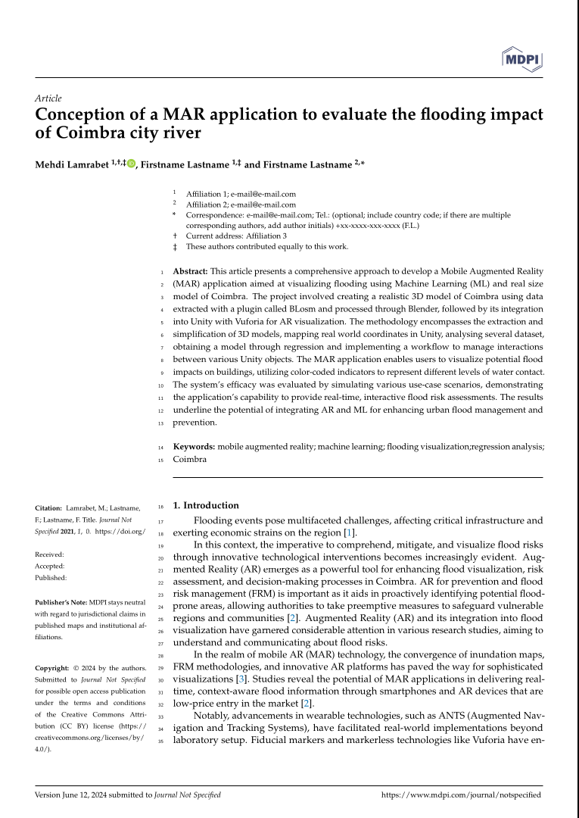
Article in
preparation to
submit until
the end of June
Conception of a MAR application
to evaluate the river flooding impact in Coimbra
Mehdi Lamrabet

Slide 35
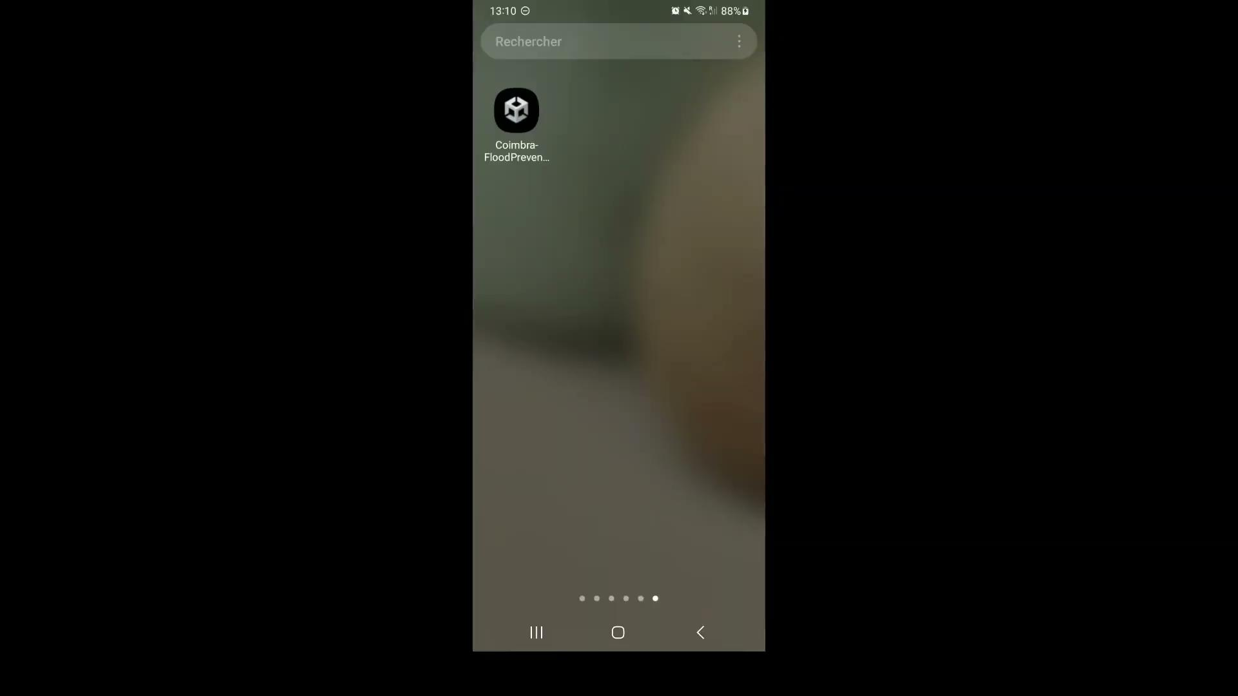
Conception of a MAR application
to evaluate the river flooding impact in Coimbra
Mehdi Lamrabet

Slide 36
Conception of a MAR application
to evaluate the river flooding impact in Coimbra
Mehdi Lamrabet
Thank you for your attention !
Any questions ?

